Slide 1
Event‑Based Earnings Prediction Pipeline
$
A reproducible system for downloading data, building event windows, and testing predictive models
Authors: Harsh Choksi, Ryaan Zaheed

Slide 2
What the Project Does (High‑Level Overview)
Fully automated pipeline that:
Downloads daily price data
Downloads earnings announcement data
Stores both in a relational SQLite database
Generates event windows around each earnings announcement
Builds a modeling dataset with engineered features
Trains models to predict post‑earnings reaction direction
Designed for reproducibility, clean data alignment, and leakage‑free evaluation
Data
DB
Event Window
Features
Model
Results

Slide 3
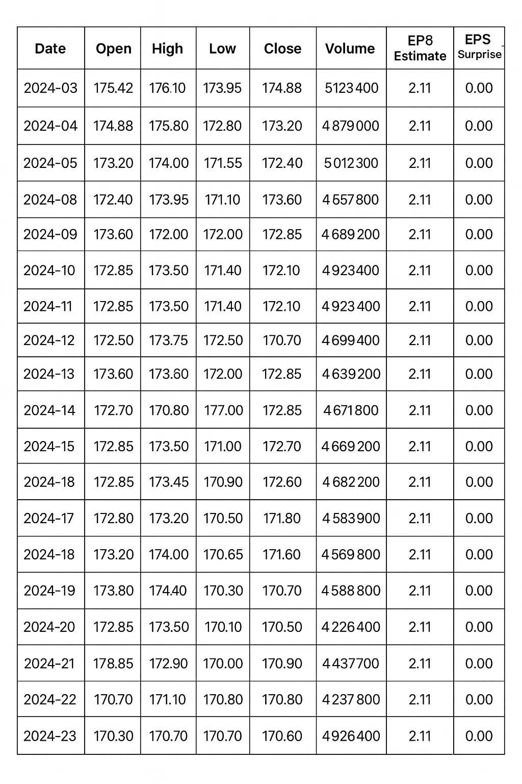
Data Inputs
Price Data
Daily OHLCV (Open/High/Low/Close/Volume)
Earnings Data
Announcement date
Actual EPS
Estimated EPS
Surprise value
Universe
Selected list of US equities across multiple sectors

Slide 4
Database System (SQLite)
Why a database?
Ensures clean joins between prices and earnings
Avoids inconsistent CSV merges
Makes the pipeline repeatable and extendable
Tables
companies
daily_prices
earnings_announcements
$
Company
Daily Prices
Earnings Announcements

Slide 5
Event Window Construction
Key idea:
For each earnings announcement, build a [-3, +3] trading-day window.
What we compute:
Daily returns
Cumulative returns
Pre‑event context features (momentum, volatility, volume patterns)
Earnings-history features (previous surprise, beat streak)
Day -3
Day 0
Day 3

Slide 6
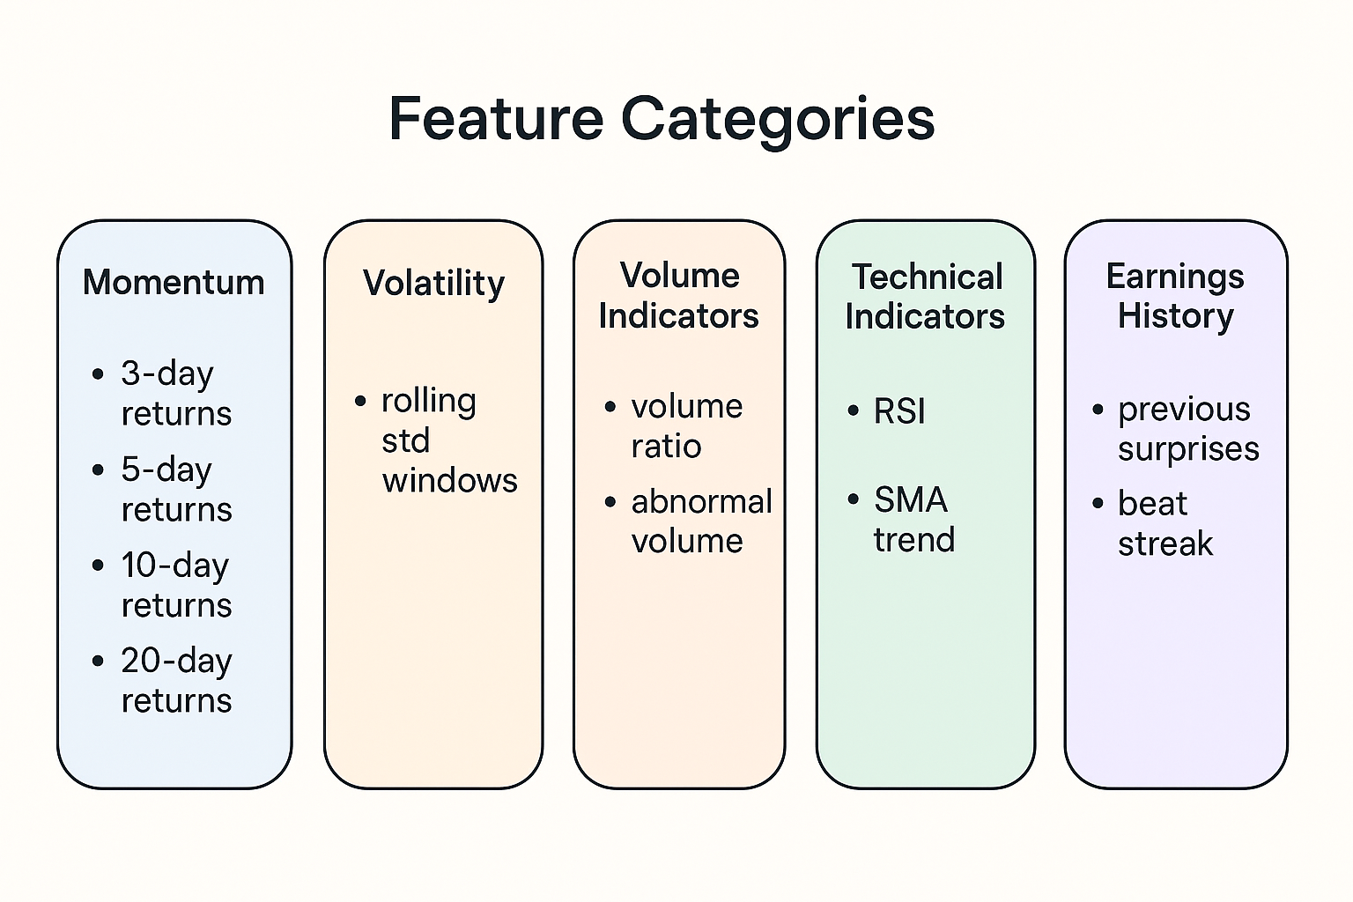
Feature Engineering
Features include:
Momentum: 3-day, 5-day, 10-day, 20-day returns
Volatility: rolling volatility measures
Volume indicators: volume ratios
Technical indicators: RSI, SMA trend relationships
Earnings history: past surprises, beat frequency
These form the input vector for each event.
$
$

Slide 7
Modeling Setup
$
Target Variable:
Direction of immediate price reaction
Positive (=1) if return from Day 0 to Day +1 is > 0
Models Tested:
Logistic Regression
Random Forest
Gradient Boosting
Evaluation Approach:
Time‑based split (train on past years, test on actual unseen future events)
Baseline: majority-class prediction
$
Train
(2020–2024)
Test (2024–2025)

Slide 8
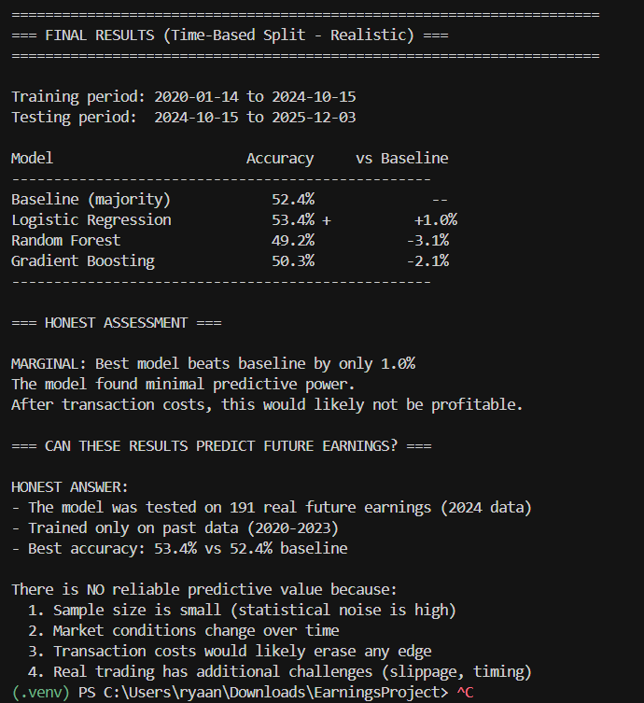
Results (Realistic Time‑Based Split)
Accuracy (Test Set):
Baseline (majority): 52.4%
Logistic Regression: 53.4% (+1.0%)
Random Forest: 49.2%
Gradient Boosting: 50.3%
Interpretation:
Best model provides only a minor 1% improvement over baseline - Barely above just guessing.
Statistical signal is very weak. More information is needed, given how intricate the market is (Earnings Transcripts, Guidance information, Options flow, Sector Performance, and literally tens of hundreds of other things)
After transaction costs, no profitable edge is likely - Room for improvement, but good base model!

Slide 9
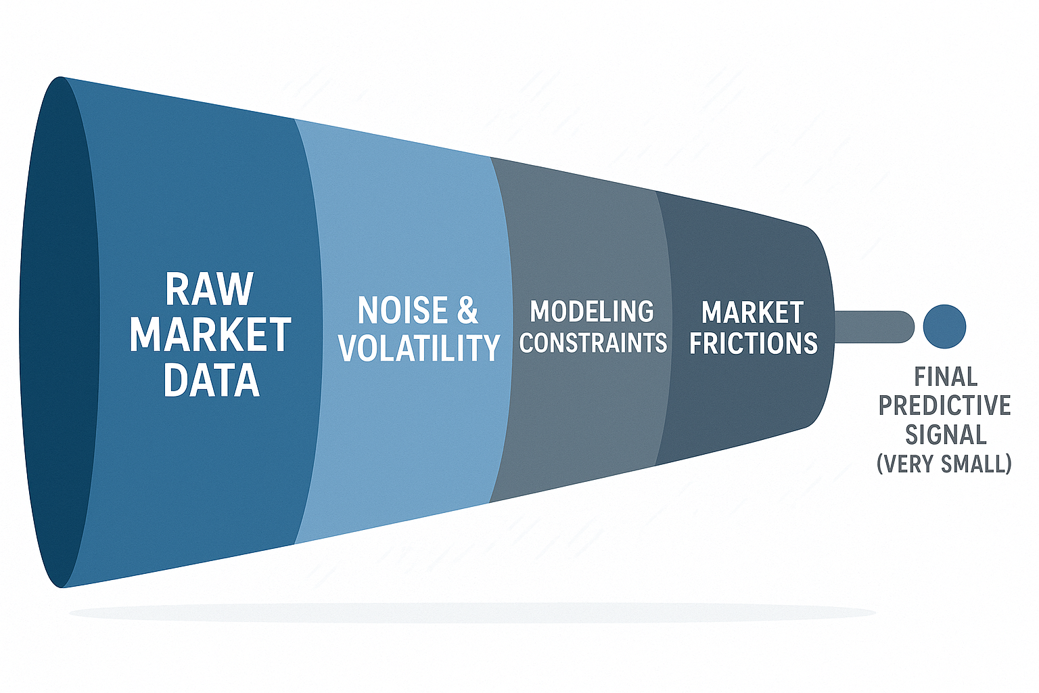
Why Predicting Earnings Is Hard
Small number of events → noisy outcomes
Market conditions shift over time
Price movement around earnings is often dominated by unpredictable information shocks
Transaction costs and execution friction eliminate tiny statistical edges

Slide 10
Key Takeaways + Next Steps
Takeaways
Pipeline successfully automates data collection, storage, windowing, and modeling
Evaluation is realistic and leakage‑free Models detect minimal predictive power
Next Steps
Expand ticker universe for more events
Add market-context features (sector returns, volatility indices)
Try multi-class prediction (large up / flat / large down)
Explore deeper models (neural nets, sequence models)

